Slide 1
Bootstrap
Overview, tutorial and examples
Developed 2023 by PJ Perri - Mount Royal University
Based on copyright materials from: W3Schools (Terms of service) and Bootstrap (CC by 3.0)

Slide 2
What is covered in this presentation
What is Bootstrap
How to access it and set up your own Bootstrap web page
Basic containers
Responsive containers
Bootstrap Grid
  rows, column, column-sizes
  Examples
Utility Classes. Predefined:
  Text and background colors
  Sizes
  Borders
  Spacing
  Typography
    Headings and Text
    Tables
  Other silly / useful ones

Slide 3

What is it?
“Powerful, extensible, and feature-packed frontend toolkit” (AKA framework) .
Provides very well supported, customizable, prebuilt, responsive (mobile-first):
  Grid system
  Components
    Fonts, colors, tables, images, buttons, badges, spinners, cards, dropdowns, navs, tooltips, etc.
  Sass
  JavaScript plugins
Free, open-source, originally developed at Twitter

Slide 4
Other frontend web frameworks
Client-side
Server-side
Google Web Toolkit
jQuery & j QWidgets
W3.CSS
WordPress
Joomla
ASP.NET
C++ Drogon
ColdFusion Markup Language
Java Apache
PHP
Python

Slide 5
Bootstrap 5: the Latest Version
Supports/supported by the latest stable browsers and platforms
  Bootstrap 3 and 4 are still used and supported but new features will not be added
    Why? They’ve moved to JavaScript instead of jQuery library
You will need to either download and host Bootstrap (all its CSS and JS files) yourself,
  Currently v5.3.0-alpha1 · Download and place in your web site
or
Commonly, include it from a Content Delivery Network (CDN)
  A server to provide the Bootstrap CSS and JavaScript

Slide 6
Including Bootstrap via CDN
1.
2.
3.
4.
5.
6.
<!doctype html>
<html lang="en">
<head>
  <meta charset="utf-8">
  <meta name="viewport" content="width=device-width, initial-scale=1">
  <title>Bootstrap demo</title>
  <link href="https://cdn.jsdelivr.net/npm/bootstrap@5.3.0-alpha1/dist/css/bootstrap.min.css" rel="stylesheet" integrity="sha384-GLhlTQ8iRABdZLl6O3oVMWSktQOp6b7In1Zl3/Jr59b6EGGoI1aFkw7cmDA6j6gD" crossorigin="anonymous">
  </head>
  <body>
  <h1>Hello, world!</h1>
  <!– the rest of the html-->
  <script src="https://cdn.jsdelivr.net/npm/bootstrap@5.3.0-alpha1/dist/js/bootstrap.bundle.min.js" integrity="sha384-w76AqPfDkMBDXo30jS1Sgez6pr3x5MlQ1ZAGC+nuZB+EYdgRZgiwxhTBTkF7CXvN" crossorigin="anonymous"></script>
  </body>
</html>
Critical code in <head>:
  HTML5 doctype
  lang
  character set
  meta viewport
    For proper rendering and touch zooming
  <link> to Bootstrap’s “minified” CSS in the head
  <script> to a JavaScript bundle just before </body>
For latest and complete links, see
https://getbootstrap.com/

Slide 7
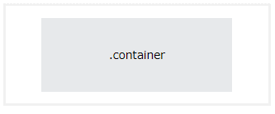
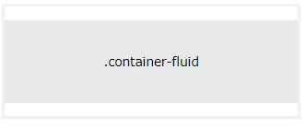
Basic Containers:
.container
  Responsive fixed width
.container-fluid
  Full viewport width spanning
! Bootstrap globally sets:
  box-sizing: border-box

Slide 8
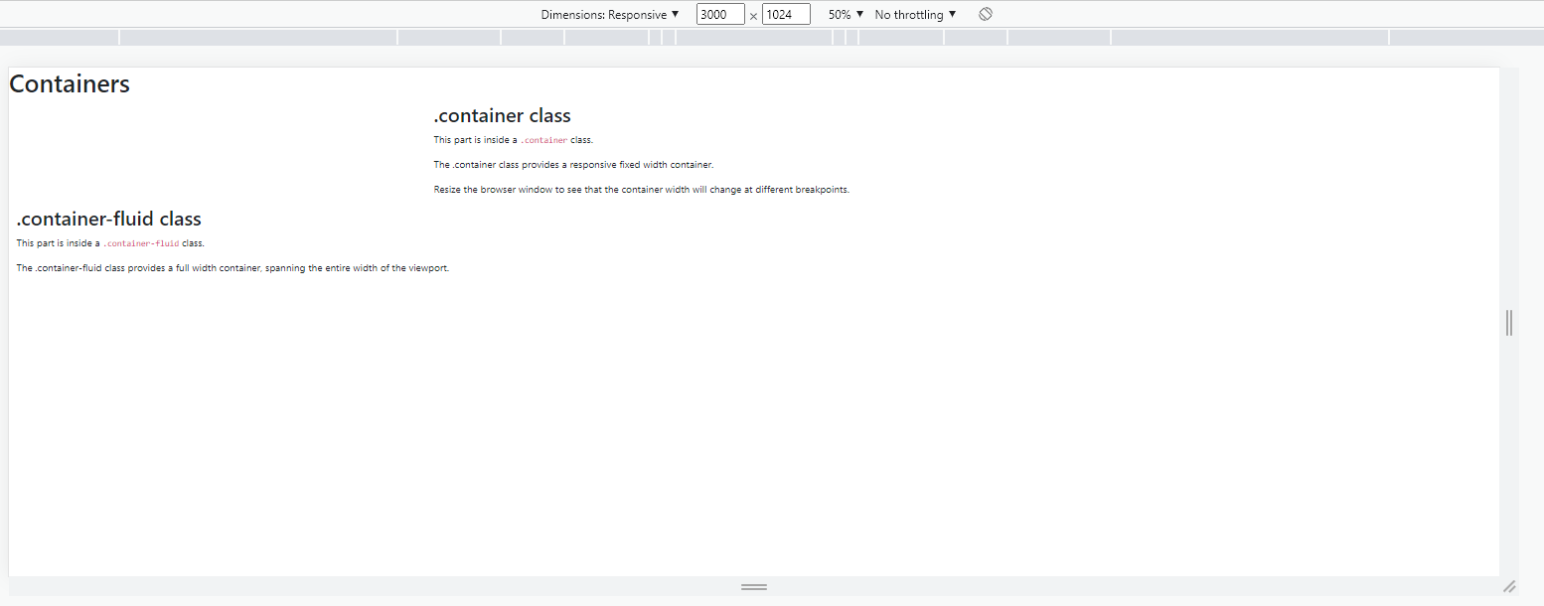
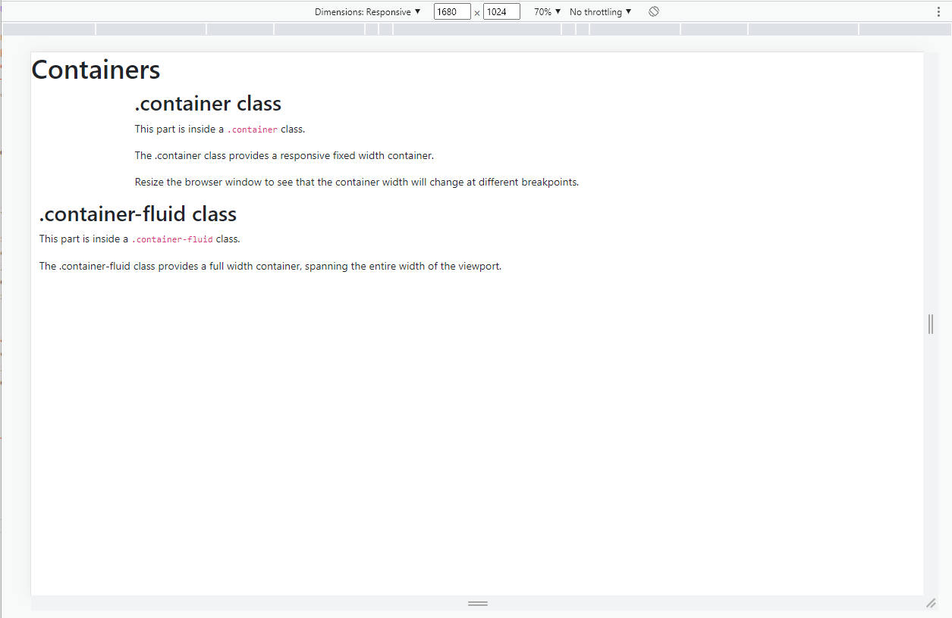
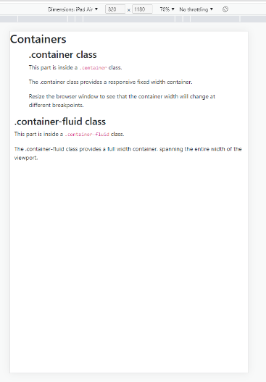
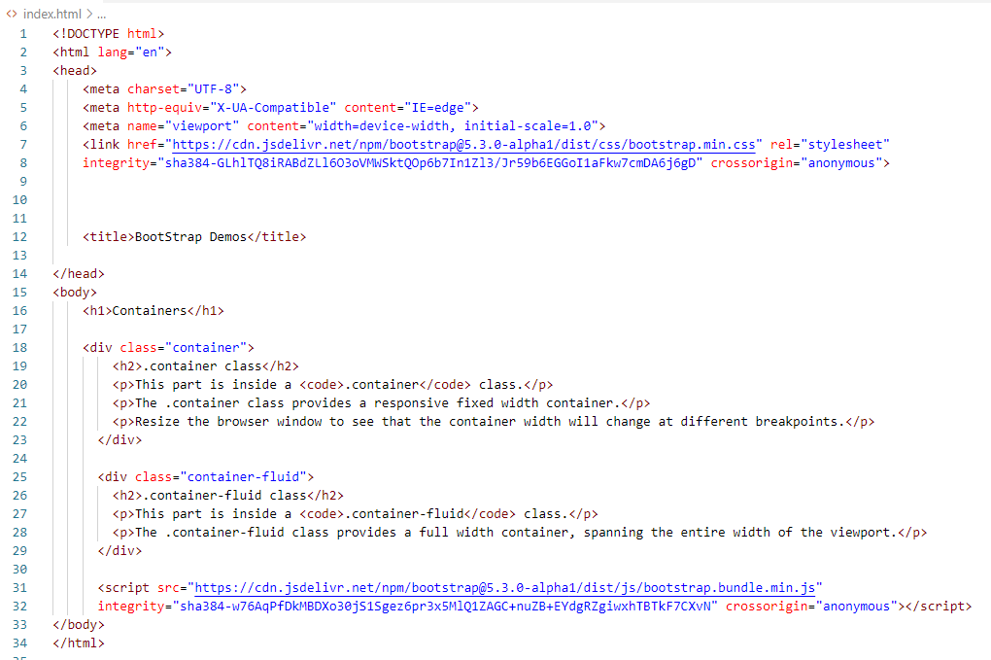
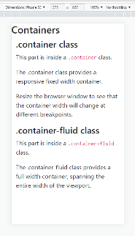
Notes:
<!DOCTYPE html>
<html lang="en">
<head>
<meta charset="UTF-8">
<meta http-equiv="X-UA-Compatible" content="IE=edge">
<meta name="viewport" content="width=device-width, initial-scale=1.0">
<link href="https://cdn.jsdelivr.net/npm/bootstrap@5.3.0-alpha1/dist/css/bootstrap.min.css" rel="stylesheet"
integrity="sha384-GLhlTQ8iRABdZLl6O3oVMWSktQOp6b7In1Zl3/Jr59b6EGGoI1aFkw7cmDA6j6gD" crossorigin="anonymous">
<title>BootStrap Demos</title>
</head>
<body>
<h1>Containers</h1>
<div class="container">
<h2>.container class</h2>
<p>This part is inside a <code>.container</code> class.</p>
<p>The .container class provides a responsive fixed width container.</p>
<p>Resize the browser window to see that the container width will change at different breakpoints.</p>
</div>
<div class="container-fluid">
<h2>.container-fluid class</h2>
<p>This part is inside a <code>.container-fluid</code> class.</p>
<p>The .container-fluid class provides a full width container, spanning the entire width of the viewport.</p>
</div>
<script src="https://cdn.jsdelivr.net/npm/bootstrap@5.3.0-alpha1/dist/js/bootstrap.bundle.min.js"
integrity="sha384-w76AqPfDkMBDXo30jS1Sgez6pr3x5MlQ1ZAGC+nuZB+EYdgRZgiwxhTBTkF7CXvN" crossorigin="anonymous"></script>
</body>
</html>

Slide 9
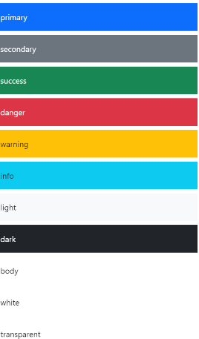
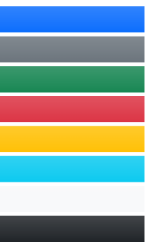
Bootstrap’s Color Classes
Bootstrap has a bunch of pre-defined color classes that one can use to set text & background colors
  Standardized names for text colors
    .text-muted, .text-primary, .text-success, .text-info, .text-warning, .text-danger, .text-secondary, .text-white, .text-dark, .text-body (default body color/often black) and .text-light
  Standardized names for background colors
    .bg-primary, .bg-success, .bg-info, .bg-warning, .bg-danger, .bg-secondary, .bg-dark, & .bg-light
    Can also add additional bg.gradient class
  Contrast issues solved with .text-bg-color classes
    .text-bg-primary, .text-bg-success, .text-bg-info, .text-bg-warning, .text-bg-danger, .text-bg-secondary, .text-bg-dark, & .text-bg-light
Gradients

Slide 10
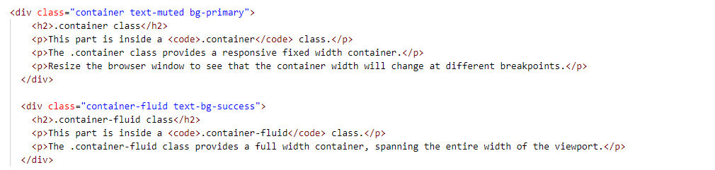
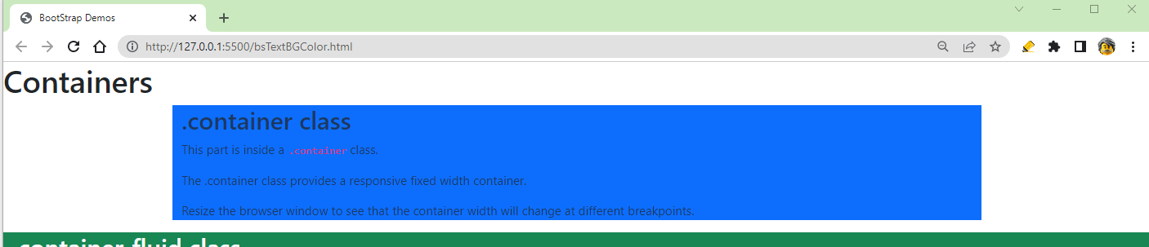

Slide 11
Other Colors V5
Dark and light modes can be applied to any element or the entire page:
  <html lang="en" data-bs-theme="dark">
  <html lang="en" data-bs-theme="light">
Simple application:
  Create two versions of the pages and use link (consistently located on each page) to jump between the two.
https://getbootstrap.com/docs/5.3/customize/color/

Slide 12
There are other Bootstrap Utility Classes
Some of these are responsive and depend on breakpoints.
Borders
  Have or not have
  Position (top, bottom, left, right, top & bottom, left & right)
  Colors & weights
  Rounding none, some or all corners
Spacing
  Margins & Padding
    Position & sizes
Display
  Inline, inline-block, block
  Grid
  Table, table-cell, table-row
  Flex, inline-flex
  Hiding with none
Settings | Sizes
1 | 0.25rem
2 | 0.5rem
3 | 1rem
4 | 1.5rem
5 | 3rem
auto | Used with centering etc.
But first….

Slide 13
Bootstrap Responsive Breakpoints
Any.container-fluid class element will resize itself and its contents (from edge to edge of screen)
A .container class element will resize at Bootstrap set breakpoints
  Come in a set sizes: xs, sm, md, lg, xl & xxl.

Slide 14
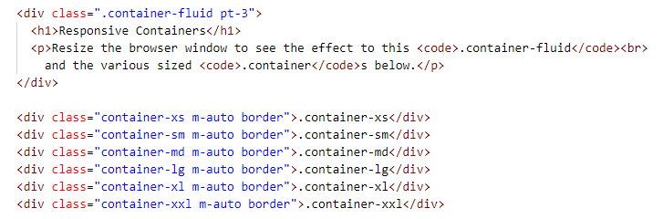
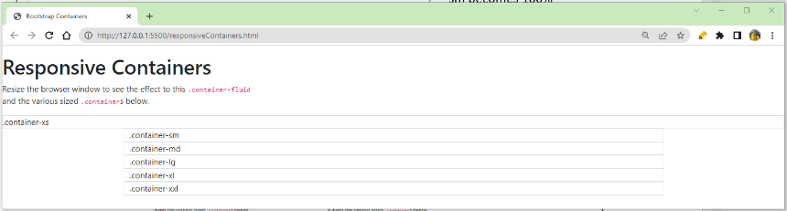
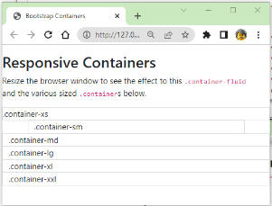
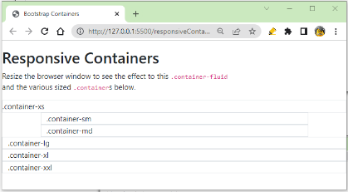
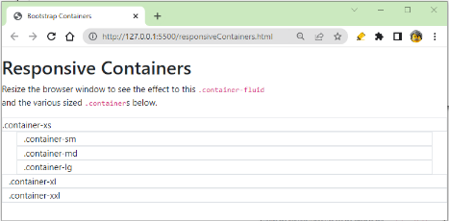
.container-flude is always 100% wide & contents resizes
xs container is always 100% wide

Slide 15
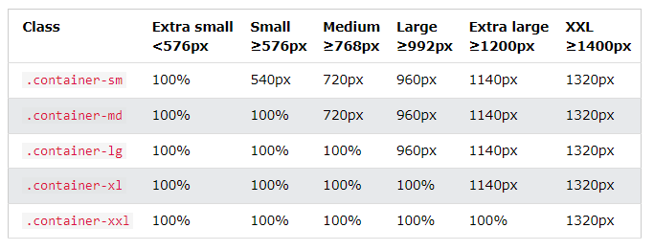
Responses at Breakpoints

Slide 16

But what if you don’t just want the layout to be a stack of block container elements?

Slide 17
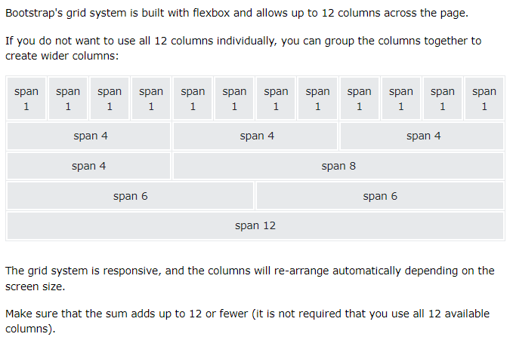
Bootstrap Responsive Grid
For more control than what was provided by individual .container or .container-fluid class elements, use Bootstrap’s grid.
  mobile-first, fluidly responsive grid system
  12-columns
  Applied to an element with either .container or .container-fluid, class
  The grid is created of row class elements nested within the container
  Within each row are elements that are placed in/spanning the 12-columns via the col class.

Slide 18
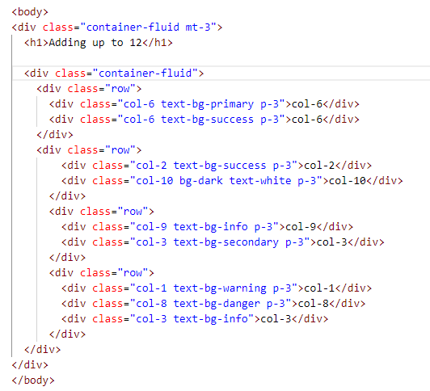
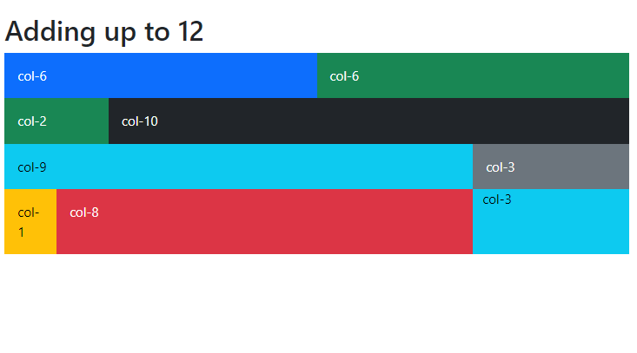
Container→ Rows
→ Elements adding up to 12 columns

Slide 19
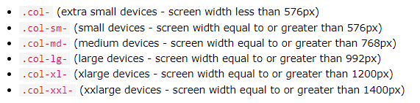
Column sizes
SEPARATE FROM CONTAINER SIZES
There are 6 grid column classes
  They control the width of the element based on screen size
  Each class scales up, so if you want the same widths for sm and md, you only need to specify sm.

Slide 20
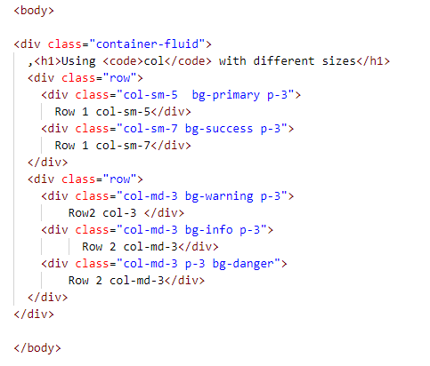
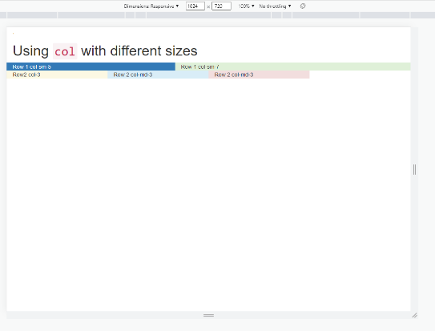
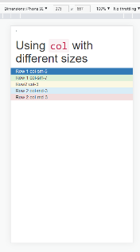
Column sizing example

Slide 21
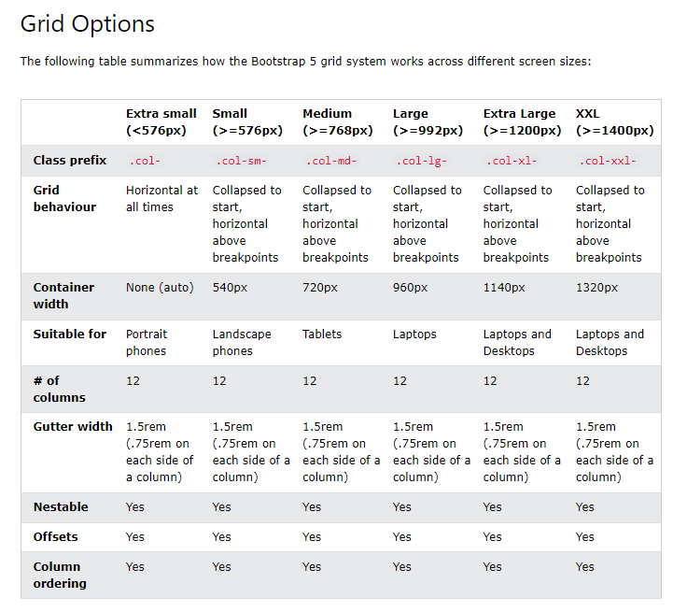

Slide 22
Grid System
Must be contained in a .container or .container-fluid
Uses a .row as a wrapper for each new row
Columns are flexible but
there will be 12
6 responsive breakpoints
  Based on screen width
  Effects all sizes above
    col applies to all
    sm to md, lg, xl, & xxl
    Etc.

Slide 23
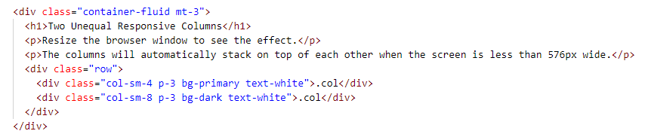
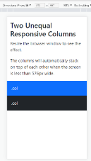
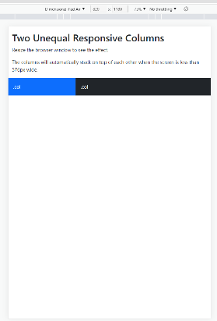
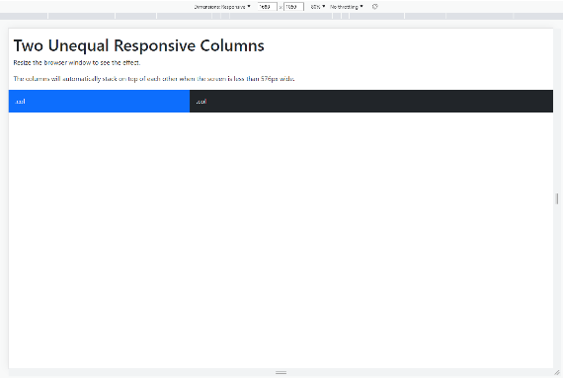
All contained in a container-fluid class div – thus its H1 and p are full width and will both resize contents.
Within, 1 row class containing 2 col classes, both sm & both -3 sized(1rem) padding
  one spanning -4 (of 12) and the other spanning the remaining -8.
  Each with different bg- and text- colors.
  Notice:
    When screen is very small→ stacked
    When screen is bigger column items resize based on the size of the screen.

Slide 24
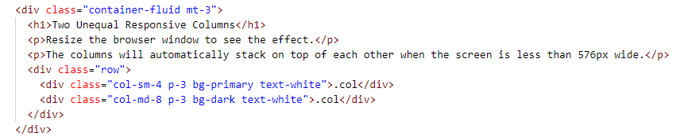
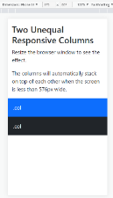
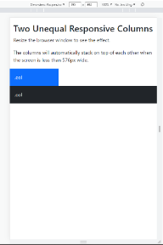
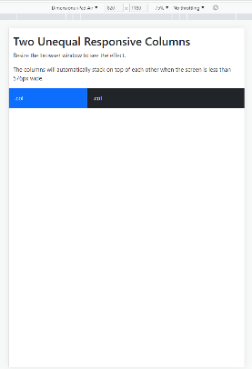

Again contained in a container-fluid class div, but this time:
  one sm column spans -4 and second md-8, a larger-size column spanning remaining columns
  Notice:
    When screen is very small→ still stacked
    Odd in-between size → stacked but “md” displays to its size
    When screen is big enough (breakpoint), columns resize based on the size of the screen regardless of col size.

Slide 25
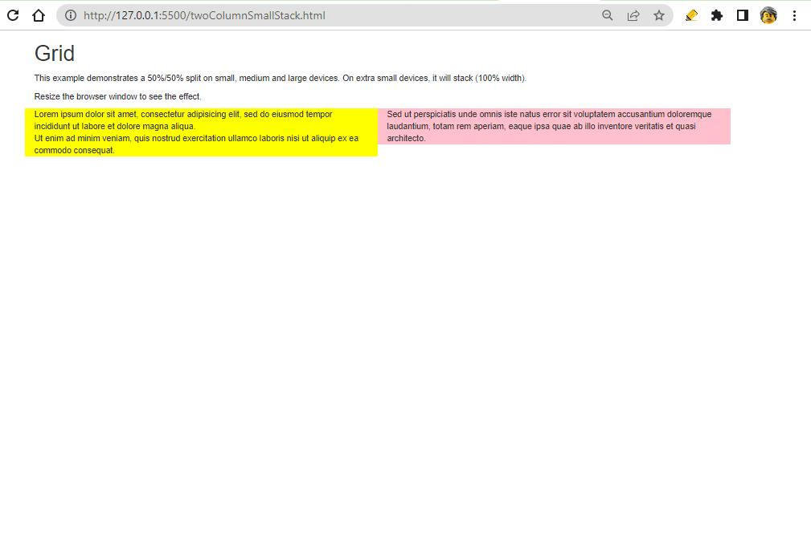
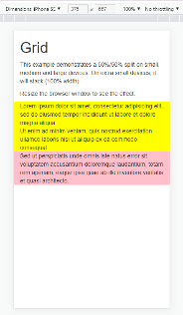
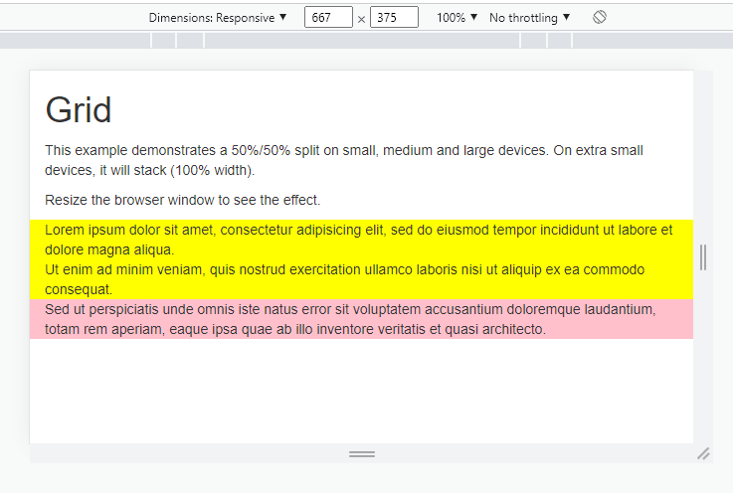
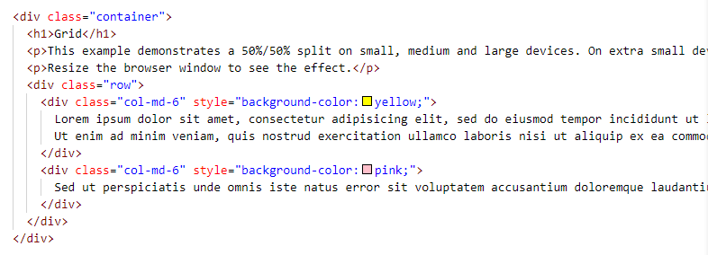
Two-Column Layout – “Stacked-to-horizontal”
Two 50% by 50% columns
EXCEPT on small screens (<576px so phones portrait or landscape) when they will stack.
If you wanted them to stack at other breakpoints, use different col-size:
  Use: col-md
  and elements be two columns on tablets and bigger, but stack on smaller screens.
  Note: If you use just col, they columns always stack.
https://www.w3schools.com/bootstrap/bootstrap_grid_stacked_to_horizontal.asp

Slide 26
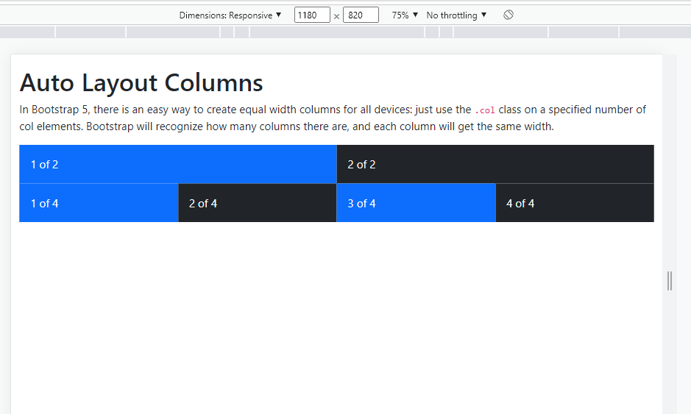
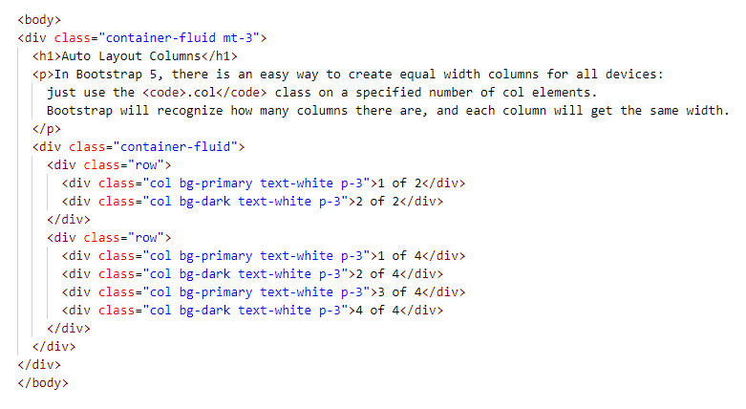
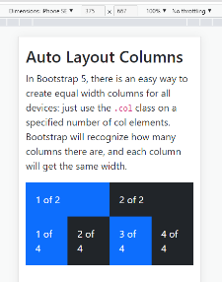
Auto Columns for all devices:
An easy way to create equal width columns for all devices:
  Just use the .col class with a number of col elements.
    1x12, 2x6, 3x4
  Bootstrap will recognize how many columns there are, and
  each column will have equal width.
Example:
  Two rows
    1st has two col
    2nd has 4 col
  No col- sizes so Bootstrap assumes

Slide 27
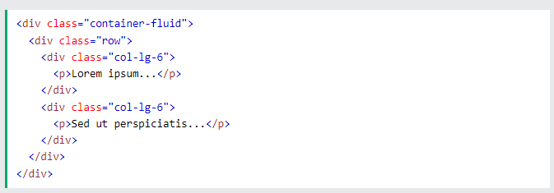
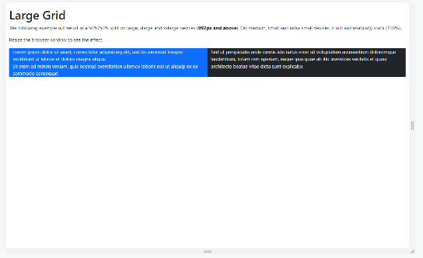
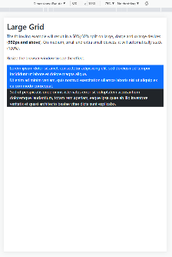
Stack for all but Large Screens
(aka portable = always stacked)
Using only col-lg (in this case 2 equal columns of 6) means:
On large, x-large, & xx-large devices,
columns split 50%/50%,
but most small (portable) devices will stack).

Slide 28
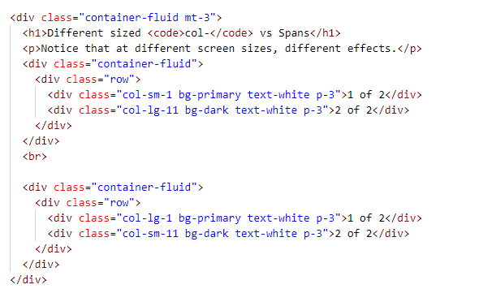
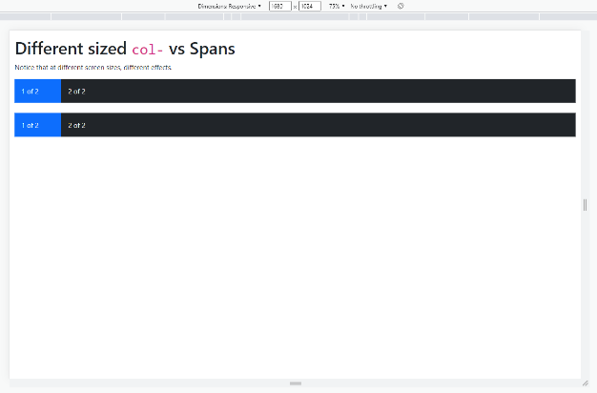
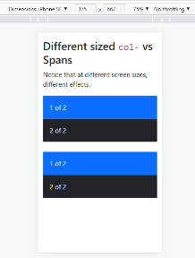
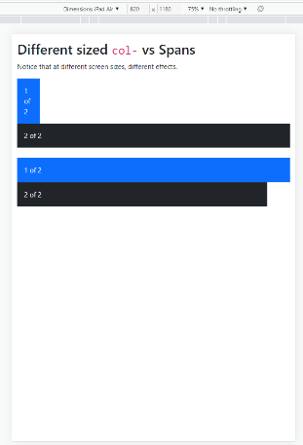
Note: choosing a class size means it will resize and stack according to its breakpoints. ≠ how many columns it spans.

Slide 29
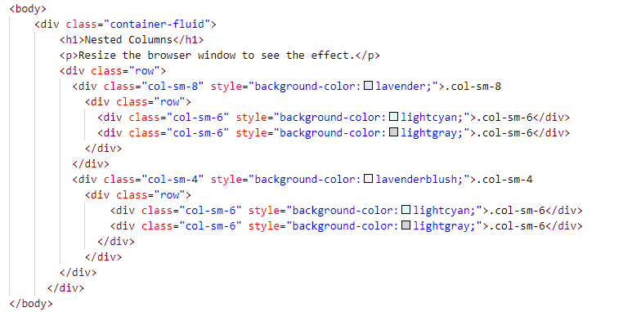
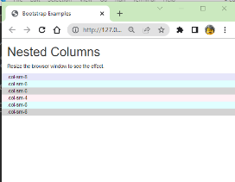
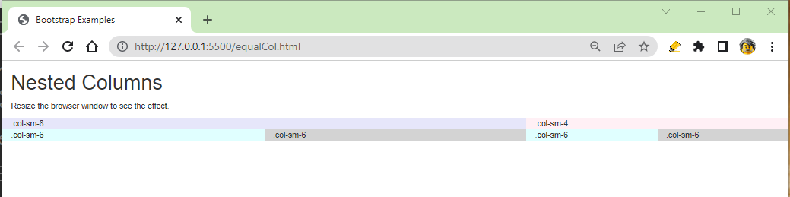
Nested Rows

Slide 30
Tips
Elements must be within a container to be able to have a grid
Set each row class,
then, place col elements within that row (as children of the row)
The spans must add up to 12
OR
the number of col class elements in the row is divisible by 12
  1x12, 2x6, 3x4
Recall, col-sizes describe how the element reacts to screen sizes…
NOT how big they are.
  Get too small, they stack
Looking for more Bootstrap column examples?
  https://www.w3schools.com/bootstrap5/bootstrap_grid_examples.php

Slide 31

Border Utility Classes
To have a Bootstrap border on an element, set the element to have the Bootstrap
border class, weight (1-5), predefined color, and/or radius
  class="border"
  class="border border-4"
  class="border border-4 border-danger rounded-5"

Slide 32

Container Spacing Utility Classes
{property}{sides}{size} for xs
And
{property}{sides}-{breakpoint}-{size}
for sm, md, lg, xl, and xxl.
Properties
  m for margins
  p for padding
Sides
  t or b for top or bottom
  y for both top & bottom
  l or r for left or right
  x for both left & right
  Default, containers have left and right padding, with no top or bottom padding.
Sizes
  Bootstrap set ‘responsive’ scale:
0 | 1 | 2 | 3 | 4 | 5 | auto
0 | 0.25rem | 0.5rem | 1rem | 1.5rem | 3rem | centered
Additionally, .mx-auto class will horizontally centering fixed-width block level content—i.e. content that has display: block and a width set—by setting the horizontal margins to auto.

Slide 33


Spacing Containers
Note: We’ll return to Bootstrap grids (gaps) later
https://mdbootstrap.com/docs/standard/utilities/spacing/

Slide 34



Fonts: Headings
Similar to the six heading levels you are used to, but..
  Larger & lighter font
And… will resize as much as they can:

Slide 35

More Typography Classes
JBYCDMYS

Slide 36
Bootstrap Table Classes
Basic styling
<table class="table">
Striped
<table class="table table-striped">
Bordered
<table class="table table-bordered">
Hover effect
<table class="table table-hover">
Using pre-defined colors on rows
<tr class="table-success">
<tr class="table-danger">
Table Head color
<thead class="table-dark">
Scrollable table (when placed within a container, that holds a div, that holds the table)
<div class="container mt-3">
<div class="table-responsive">
<table class="table">

Slide 37
Other Silly and Useful Utility Classes
class = "shadow"
Also shadow–sm & shadow-lg
class = "small"
class = "mark"
Highlights text
class = "invisible"
Changes the CSS visibility property
class = "visually-hidden"
Makes the element hidden on all screens EXCEPT for screen readers.

Slide 38
Still to come (some or all of):
Image classes
“Jumbotron”
Buttons & Button Groups
Pagination
Lists
Forms
Cards
Dropdowns
Navs & Navbars
Tooltip
Carousel
Flexboxes

